Slide 1

HOW TO MAKE QUALITY ANDROID APPs
Hai Nguyen Technical Lead – CBA Digital Solutions
@minhhai8507

Slide 2
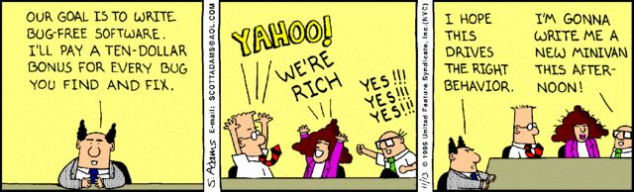
What defines quality of an app?
No(less) bugs
Maintainability
Scalability
Performance
Code smells
Vulnerabilities
…

Slide 3
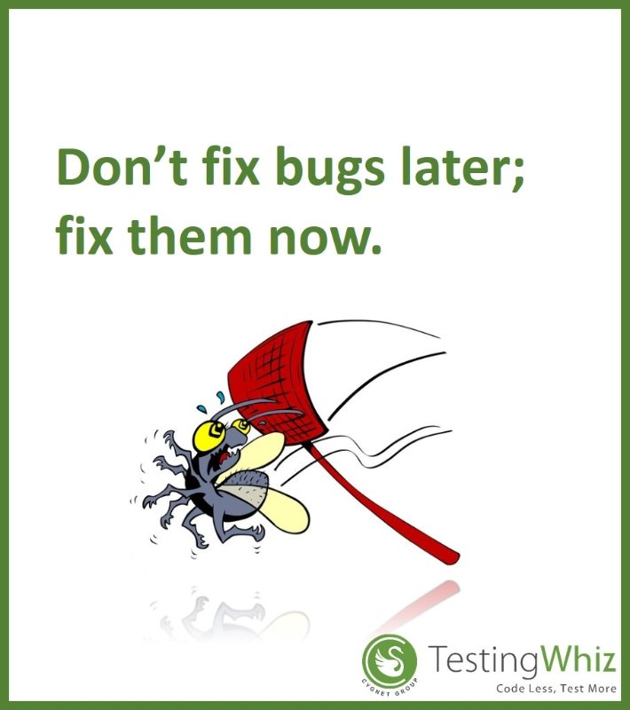
How to improve the quality?
Testing
Unit test
Automation test
Architecture
Static code analysis
Code review
Continuous integration
Culture

Slide 4
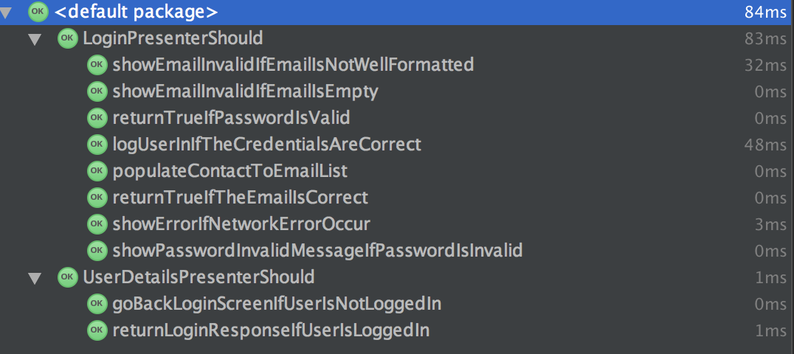
Why Android so hard to write unit test?
Android framework dependencies
Tight coupling
Slow start-up and execution time
Run on real device or emulator

Slide 5

How to make unit test easier in Android
Remove the dependency with Android framework
Loose coupling, separation of concerns
Dependency Injection
S.O.L.I.D
Architecture patterns
MVP
MVVM
Redux
Riblets
…

Slide 6
We choose MVP
View as dump as possible
All the logics are in Presenters
Models are basically POJOs
Android OS
Presenter
View
Model

Slide 7
View
Stream
Subscriber<T>
Presenters
Business rules/
Use Cases
Observable<T>
Repository
Subscriber<T>
Database
API

Slide 8
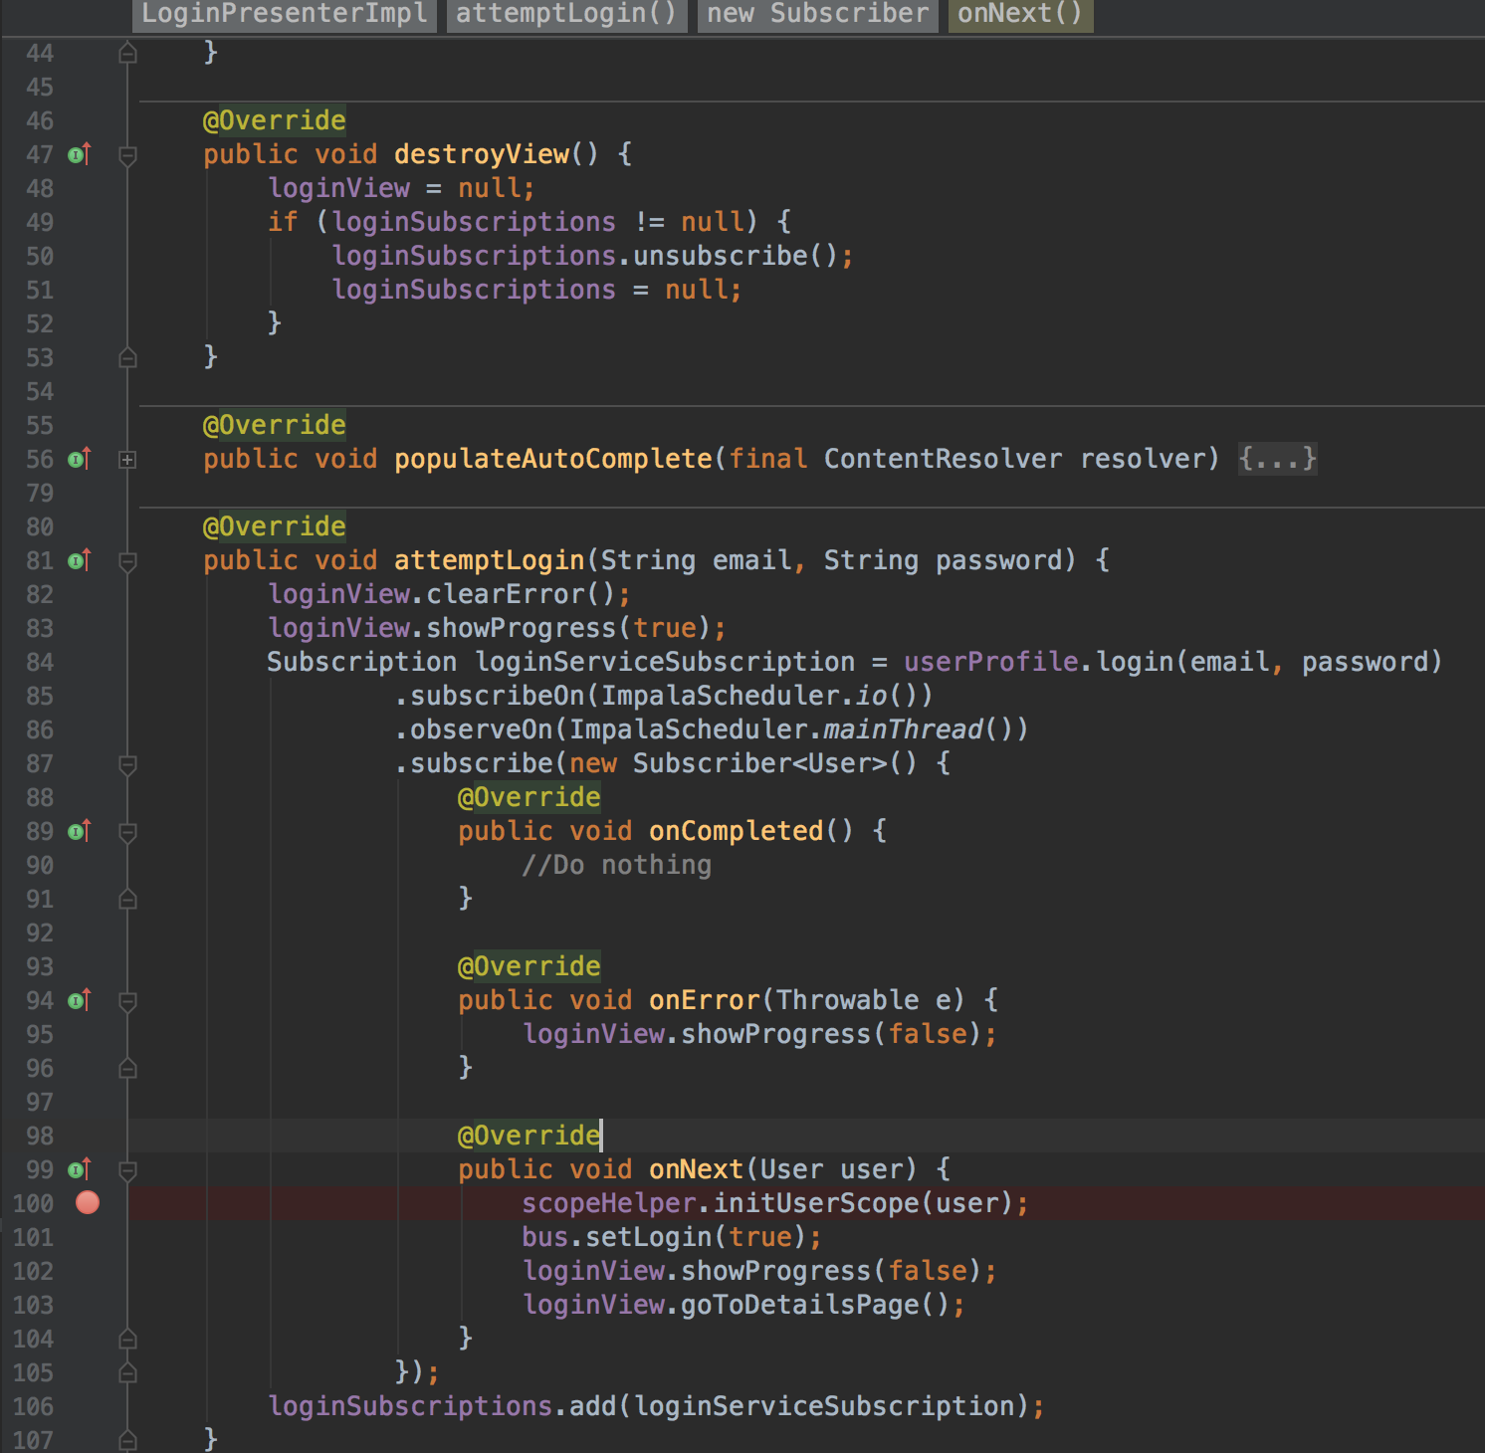
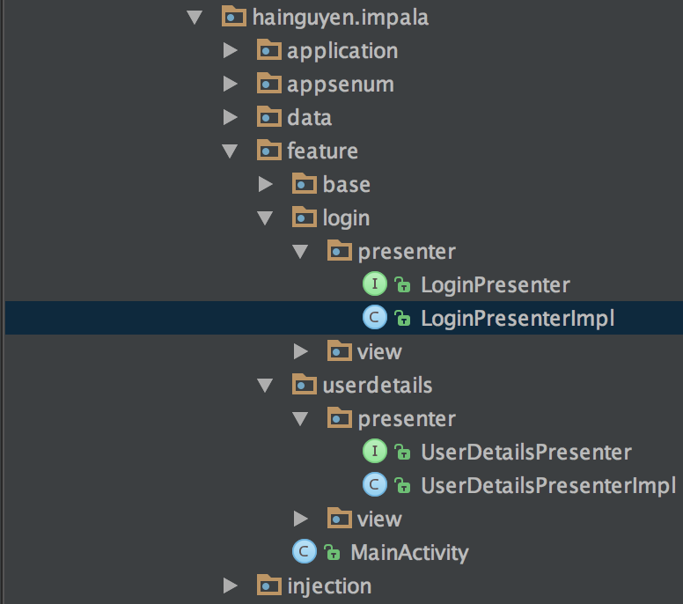
How it looks like?

Slide 9
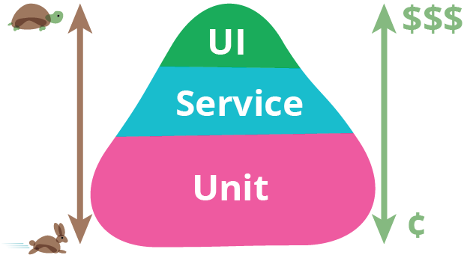
What else can we test?
Ref: https://martinfowler.com/bliki/TestPyramid.html

Slide 10
Automation test
Automation frameworks
Appium for Android and iOS
Calabash for Android and iOS
MonkeyTalk for Android and iOS
Robotium for Android
Selendroid for Android
….
Automated
Run on multiple devices
Detects UI and functional bugs
Requires coding skills

Slide 11
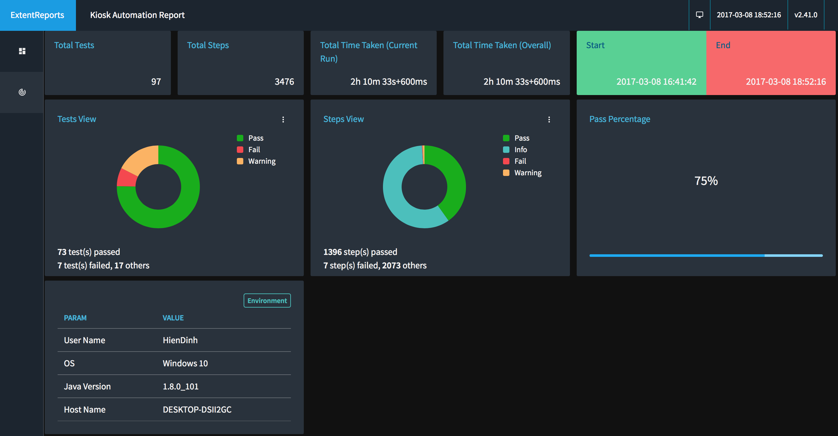
CBA Solution's Automation Framework
Created our own automation framework bases on Appium
Use extend reports

Slide 12
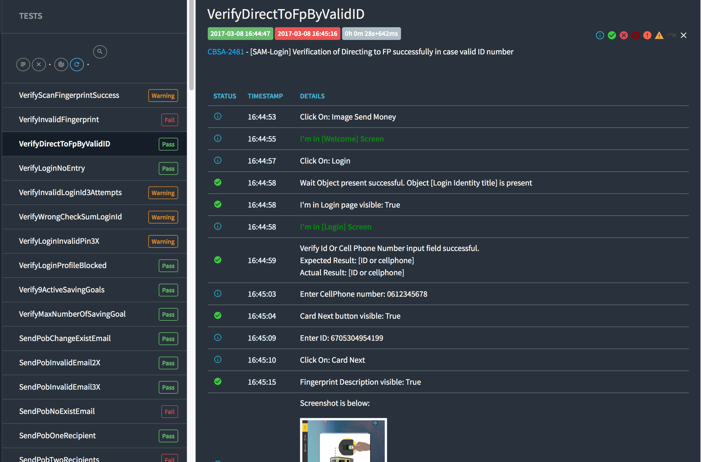

Slide 13
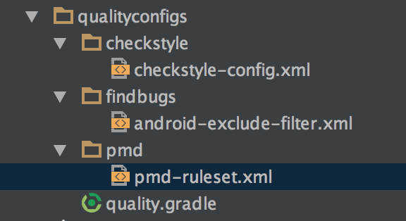
Code smells, coding style…
Detect bugs before the code get merged
SonarQube
Findbugs
PMD
Coding convention
Style check

Slide 14
Why we need static code analysis?
Detecting potential bugs,
Detecting introduced vulnerabilities,
Pointing out duplicated code,
Detecting design flaws,
Enforcing coding standards,
Detecting dead code,
Measuring technical debt,
Providing an overall view of the project health.

Slide 15

Style Check
Analyses pure source code without any major preprocessing (simple AST tree created by Checkstyle). As a consequence it is very fast.
Naming conventions,
Headers, imports,
White spaces, formatting,
Javadoc comments,
Good practices, code conventions,
Method parameters,
Cyclomatic complexity,
Any regexp.

Slide 16

Findbugs
Findbugs is a program which uses static analysis to look for bugs in Java code. Analyses byte code. Requires compilation. As a consequence, rules are able to access information not only about the currently analysed class..
Possible bugs,
Design flaws.
Bad practices,
Multithreaded correctness,
Code vulnerabilities.

Slide 17

PMD
PMD is a source code analyzer. It finds common programming flaws like unused variables, empty catch blocks, unnecessary object creation, and so forth. Analyses AST (Abstract Syntax Tree) generated by JavaCC. Does not require compilation. More advanced checks can be implemented, but still limited to one class.
Possible bugs,
Dead code,
Duplicated code,
Cyclomatic complexity,
Overcomplicated expressions,
And in fact everything that Checkstyle is capable of.

Slide 18
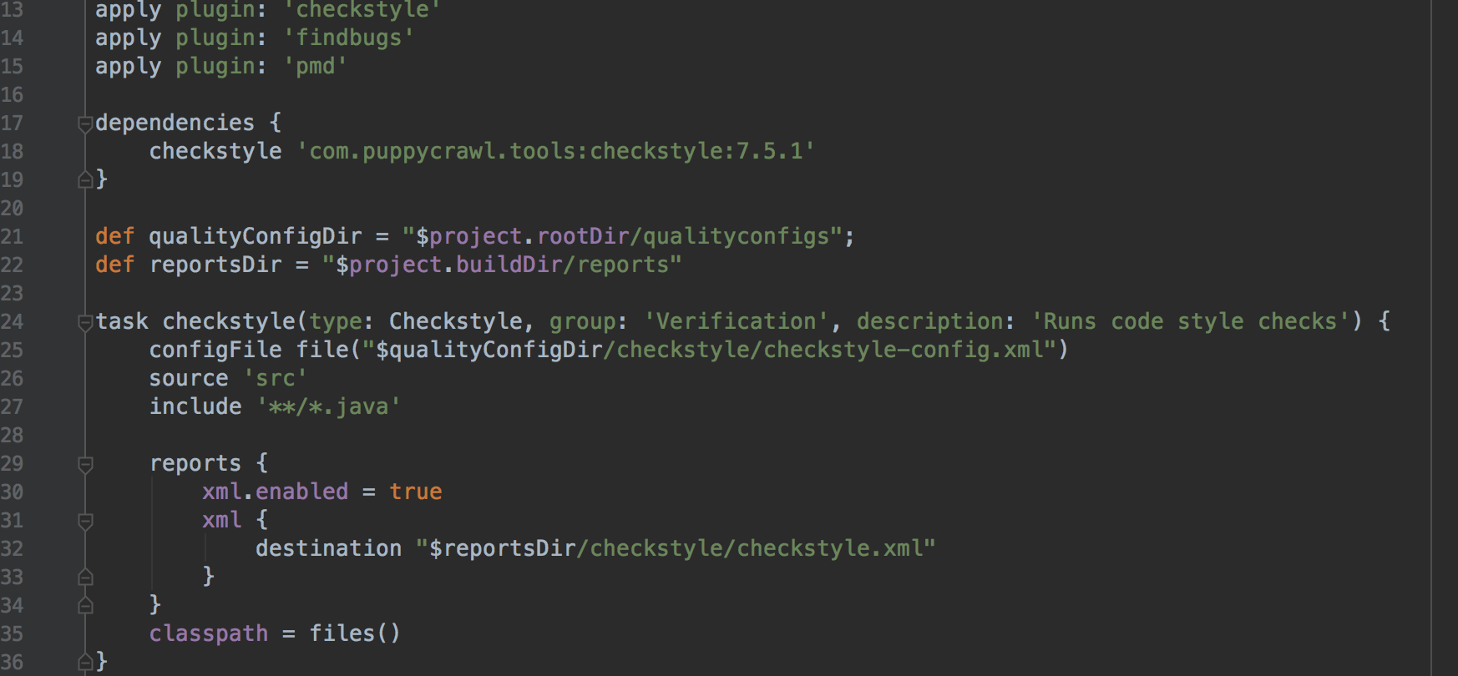
Gradle task

Slide 19
Fail fast
If bugs/defects are inevitable, how to detect them as soon as possible?
➔ Continuous Integration is a software development practice where members of a team integrate their work frequently. Each person integrates at least daily - leading to multiple integrations per day. Each integration is verified by an automated build (including test) to detect integration errors as quickly as possible. Many teams find that this approach leads to significantly reduced integration problems and allows a team to develop cohesive software more rapidly.
Martin Fowler

Slide 20
CI tools
Jenkins
TeamCity
Travis CI
Go CD
Bamboo
Circle CI
Codeship
…

Slide 21


A good build pipeline
SCM
Build
Unit Test
Code Coverage
Style Check
Sonar check
Acceptance Test
JFrog
Push
Coding

Slide 22
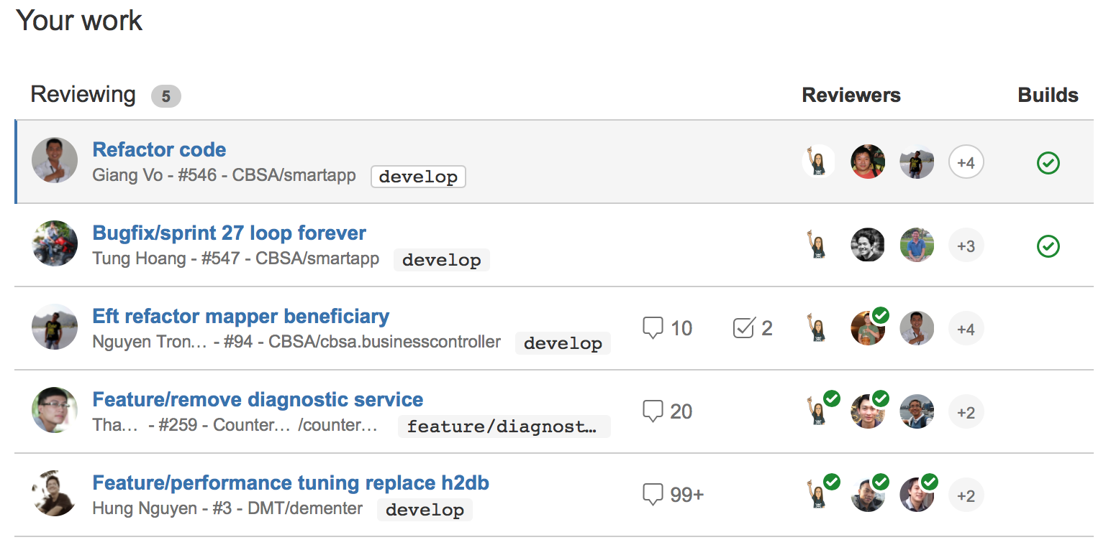
Code review

Slide 23
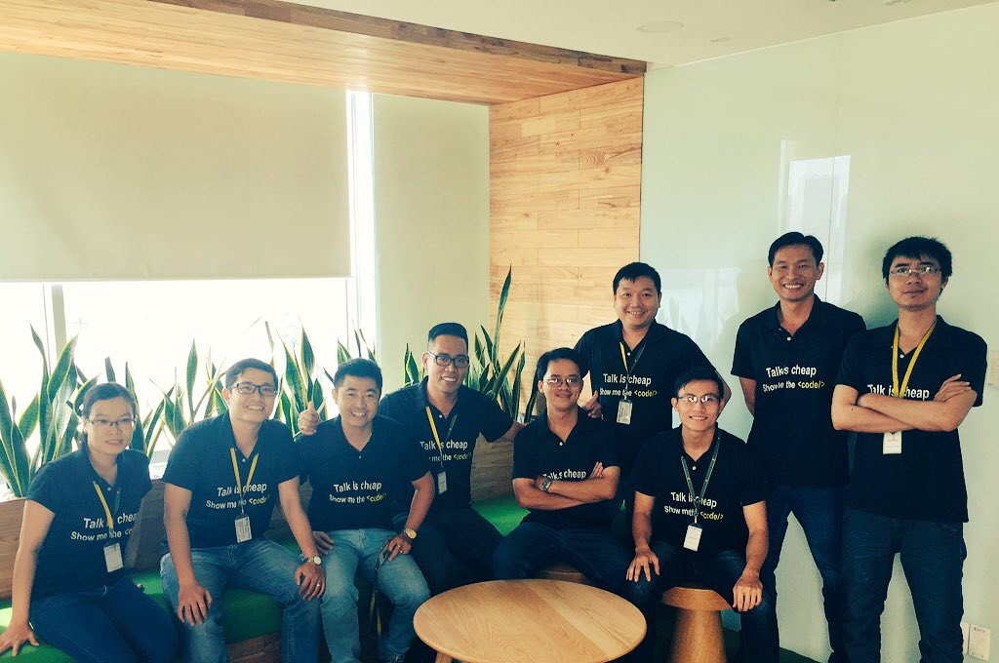
Engineering Guild
Purpose:
Sharing knowledge
Engineering Practices
Innovation
Values
Selflessness
Passion
Communication
Innovative ideas from the guild
Hercules
Achilles – the mock service
Poseidon – GA is very simple

Slide 24
Recap
Automate the testing as much as possible
Choose a good architecture works for your team
Use static analysis tools
Fail fast
Collaboration
Build an engineering culture
Sample code :https://github.com/hai-nguyen/Impala

